Slide 1

DEPARTMENT OF ARTIFICIAL INTELLIGENCE AND MACHINE LEARNING
AGI1242 – MACHINE LEARNING TECHNIQUES
BATCH - 12
Presented by :
Priyadharshini P
Priyal Nikitha V
Rangarajan K
Sakthi Vel J
Guided by :
Mr. A. Joshua Issac M.E.,(Ph.D)
ASSISTANT PROFESSOR / AI
1

Slide 2
SMART PARKING AVAILABILITY SYSTEM USING RANDOM FOREST

Slide 3
RESEARCH OBJECTIVE
The main objective of this project is to develop a machine-learning-based smart parking system that can predict the availability of parking spaces using historical and real-time parking data. Random Forest is used to analyze factors such as occupancy status, time, day, and traffic conditions to classify parking spaces as AVAILABLE or OCCUPIED. The system aims to provide reliable parking information to users, helping them find parking faster, reduce unnecessary vehicle movement, and minimize congestion in busy parking areas.

Slide 4
PROBLEM STATEMENT
Finding vacant parking spaces is time-consuming, especially in campuses, malls and busy commercial areas.
Manual and static parking monitoring cannot accurately reflect real-time changes in occupancy.
Continuous searching for parking increases traffic congestion, fuel consumption and driver frustration.
Therefore, there is a need for a reliable machine-learning model that can analyze parking and time-based data and accurately predict AVAILABLE or OCCUPIED spaces.

Slide 5
OVERVIEW
The Smart Parking Availability System collects parking-related information such as slot ID, time, day and occupancy history to understand parking patterns.
The collected data is preprocessed and important features are selected before providing it to the machine-learning model.
A Random Forest Classifier uses multiple Decision Trees and majority voting to predict whether each parking slot is AVAILABLE or OCCUPIED.
The predicted parking status can be displayed through a user dashboard, helping users identify free spaces quickly and reducing unnecessary vehicle movement.

Slide 6
ABSTRACT
The Smart Parking Availability System uses machine learning to predict the availability of parking spaces using historical and real-time parking data. The system applies a Random Forest Classifier to identify parking patterns and provide accurate availability predictions.
Data Used: Occupancy status, time, day, slot ID, traffic and environmental conditions.
Machine Learning: Random Forest combines multiple decision trees to improve prediction reliability.
Outcome: Displays available and occupied spaces through a dashboard, helping drivers reduce parking search time and unnecessary vehicle movement.

Slide 7
LITERATURE SURVEY
S.No | Paper Name | Year | Algorithm Used | Key Finding
1 | A Metadata-Based Smart Parking System Using Ensemble Learning Mechanisms for Intelligent Transportation | 2026 | Adaptive Random Forest, XGBoost | Hybrid XGBoost-Random Forest achieved 98.8% success in parking prediction and allocation.
2 | Explainable AI for Predictive Parking Space Identification Using PostCode | 2026 | Random Forest, XGBoost | Random Forest achieved 92% accuracy in predicting available parking spaces.
3 | Enhancing Urban Parking Efficiency Through Machine Learning Model Integration | 2024 | Random Forest,Linear Regression, | Random Forest was the most reliable model for predicting parking availability.
4 | Machine Learning-Based Prediction of Parking Space Availability in IoT-Enabled Smart Parking Management Systems | 2024 | Random Forest | Random Forest achieved 93.96% accuracy and outperformed the other evaluated models.
5 | Proposed Project on Parking management | 2026 | Random Forest Classifier | Classifies parking spaces as AVAILABLE / OCCUPIED using parking-related features.

Slide 8
PROPOSED SYSTEMS
1. Parking Data Input
Collect slot ID, date, time, occupancy status and other available attributes.
2. Data Preprocessing
Remove duplicates, handle missing values, encode categories and prepare clean records.
3. Feature Selection
Select useful variables such as hour, day, previous occupancy and location/slot information.
4. Train-Test Split
Divide the prepared dataset into training and testing data for fair evaluation.
5. Random Forest Training
Train multiple decision trees and combine their votes to learn parking availability patterns.
6. Prediction & Display
Predict AVAILABLE or OCCUPIED for new input data and show the result on the parking dashboard.
Final Output: Accurate parking-status classification to support faster identification of available spaces.

Slide 9
SYSTEM ARCHITECTURE
1. Parking Data
Slot status
Time & day
2. Preprocessing
Clean data
Select features
3. Random Forest
Train decision trees
Make prediction
4. Prediction
AVAILABLE
or OCCUPIED
5. User Dashboard
Show free slots
Help driver park
In Simple words
We collect parking data → clean it → Random Forest predicts the slot status → the dashboard shows whether parking is available.

Slide 10
METHODOLOGIES
1. Problem Identification
Identify parking-space availability as the problem and define the requirement for predicting vacant and occupied slots.
2. Dataset Collection
Collect parking records containing slot information, time, date, occupancy status and related attributes.
3. Data Analysis
Analyze the collected data to understand occupancy patterns, peak hours and factors affecting parking availability.
4. Model Development
Prepare the dataset and develop a Random Forest classification model using the selected parking features.
5. Model Evaluation
Test the model using unseen data and evaluate its performance using accuracy and classification results.
6. System Validation
Validate the predictions with parking-status data and verify whether the system can reliably identify available spaces.

Slide 11
DATA COLLECTION & PREPROCESSING
1. Parking Data Input
Collect parking-related data such as Slot ID, date, time and occupancy status.
The dataset contains information about whether a particular parking slot is AVAILABLE or OCCUPIED.
Historical occupancy records help the model identify parking patterns based on time and day.
Additional relevant attributes can be included if they are available in the dataset.
2. Data Preprocessing
Remove duplicate records to avoid repeated information affecting the model.
Handle missing or incomplete values so that the dataset is suitable for training.
Convert categorical information into a machine-readable format.
After preprocessing, the data becomes clean and consistent for further analysis.

Slide 12
FEATURE SELECTION & DATA SPLITTING
3. Feature Selection
Select the features that have a meaningful relationship with parking availability.
Important features can include hour, day, previous occupancy status and parking-slot information.
Irrelevant features are avoided because they may add unnecessary complexity to the model.
The selected features are used as inputs for the Random Forest model.
4. Train-Test Split
The prepared dataset is divided into training data and testing data.
The training data is used by Random Forest to learn patterns from previous parking records.
The testing data is kept separate to evaluate how well the trained model performs on unseen data.
This helps measure whether the model can generalize to new parking data.

Slide 13
RANDOM FOREST & PREDICTION
5. Random Forest Training
Random Forest is an ensemble machine-learning classification algorithm.
It creates multiple Decision Trees using different portions of the training data and features.
Each tree makes a prediction, and the final class is determined through majority voting.
The model learns the relationship between parking features and the target classes: AVAILABLE / OCCUPIED.
Using multiple trees makes the prediction more robust than relying on a single Decision Tree.
6. Prediction & Display
The trained Random Forest model receives new parking-related input data.
It predicts whether the parking slot is AVAILABLE or OCCUPIED.
The prediction results can be displayed through a parking dashboard.
Users can quickly identify available spaces and reduce parking search time and unnecessary vehicle movement.

Slide 14
CODE IMPLEMENTATION
18
import pandas as pd
from sklearn.model_selection import train_test_split
from sklearn.ensemble import RandomForestClassifier
from sklearn.metrics import (
accuracy_score,
classification_report,
confusion_matrix
)
# Load dataset
data = pd.read_csv("parking_data.csv")
# Remove duplicate records
data.drop_duplicates(inplace=True)
day_map = {
"Monday": 1,
"Tuesday": 2,
"Wednesday": 3,
"Thursday": 4,
"Friday": 5,
"Saturday": 6,
"Sunday": 7
}
traffic_map = {
"Low": 1,
"Medium": 2,
"High": 3
}
occupancy_map = {
"AVAILABLE": 0,
"OCCUPIED": 1
}
data["Day"] = data["Day"].map(day_map)
data["Traffic"] = data["Traffic"].map(traffic_map)
data["PreviousOccupancy"] = (
data["PreviousOccupancy"].map(occupancy_map)
)
data["Occupancy"] = data["Occupancy"].map(occupancy_map)
# Remove missing values
data.dropna(inplace=True)
# Input features
X = data[[
"SlotID",
"Hour",
"Day",
"PreviousOccupancy",
"Traffic"
]]
# Target
y = data["Occupancy"]

Slide 15
CODE IMPLEMENTATION
19
XTrain, XTemp, yTrain, yTemp = train_test_split(
X, y, test_size=0.30, random_state=42, stratify=y
)
XValidation, XTest, yValidation, yTest = train_test_split(
XTemp, yTemp, test_size=0.50,
random_state=42, stratify=yTemp
)
model = RandomForestClassifier(
n_estimators=100,
random_state=42
)
# Train the model
model.fit(XTrain, yTrain)
validation_predictions = model.predict(XValidation)
validation_accuracy = accuracy_score(
yValidation, validation_predictions
)
predictions = model.predict(XTest)
accuracy = accuracy_score(yTest, predictions)
print("SMART PARKING AVAILABILITY SYSTEM")
print("---------------------------------")
print("Total records:", len(data))
print("Training records:", len(XTrain))
print("Validation records:", len(XValidation))
print("Testing records:", len(XTest))
print("\nData Split:")
print("Training : 70%")
print("Validation : 15%")
print("Testing : 15%")
print("\nValidation Accuracy:",
round(validation_accuracy * 100, 2), "%")
print("Testing Accuracy:",
round(accuracy * 100, 2), "%")
print("\nClassification Report:")
print(classification_report(
yTest, predictions,
target_names=["AVAILABLE", "OCCUPIED"],
zero_division=0
))
print("Confusion Matrix:")
print(confusion_matrix(yTest, predictions))
sample = XTest.iloc[[0]]
result = model.predict(sample)[0]
if result == 0:
print("\nPredicted Parking Status: AVAILABLE")
else:
print("\nPredicted Parking Status: OCCUPIED")

Slide 16
CODE OUTPUT
20
SMART PARKING AVAILABILITY SYSTEM
---------------------------------
Total records: 1185
Training records: 829
Validation records: 178
Testing records: 178
Data Split:
Training : 70%
Validation : 15%
Testing : 15%
Validation Accuracy: 76.97 %
Testing Accuracy: 85.39 %
Classification Report:
precision recall f1-score support
AVAILABLE 0.88 0.79 0.83 82
OCCUPIED 0.84 0.91 0.87 96
accuracy 0.85 178
macro avg 0.86 0.85 0.85 178
weighted avg 0.86 0.85 0.85 178
Confusion Matrix:
[[65 17]
[ 9 87]]
Predicted Parking Status: OCCUPIED

Slide 17
IMPLEMENTATION
Input features: slot ID, occupancy history, hour, day of week, traffic level and other available contextual attributes.
Target variable: parking availability class — AVAILABLE or OCCUPIED.
Training: use a training subset to build multiple decision trees; use the remaining test subset for unbiased evaluation.
Random Forest hyper parameters can include number of trees, maximum depth, minimum samples per split and feature-selection strategy.
Accuracy
Overall correct predictions
Precision
Correct positive predictions
Recall
Ability to detect the class
F1-Score
Balance of precision & recall

Slide 18
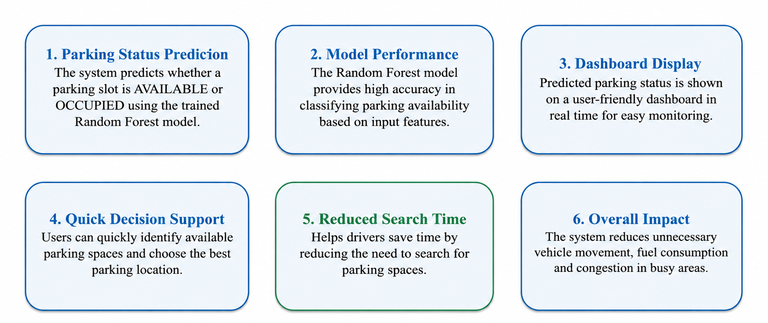
RESULT AND OUTPUT

Slide 19
CONCLUSION AND FUTURE SCOPE
The proposed Smart Parking Availability System applies Random Forest classification to predict parking-slot status.
Combining historical occupancy and contextual features can support more informed parking decisions.
The architecture connects data collection, preprocessing, machine-learning prediction, database updates and a user dashboard.
The approach can be extended from a binary slot classifier to multi-zone availability forecasting.
Future work can integrate IoT sensors, camera-based occupancy detection, cloud deployment and mobile notifications.
Advanced versions can add short-term occupancy forecasting, route guidance and dynamic parking recommendations.

Slide 20
Thank You

